Slide 1

Deep learning And Neural Networks

Slide 2
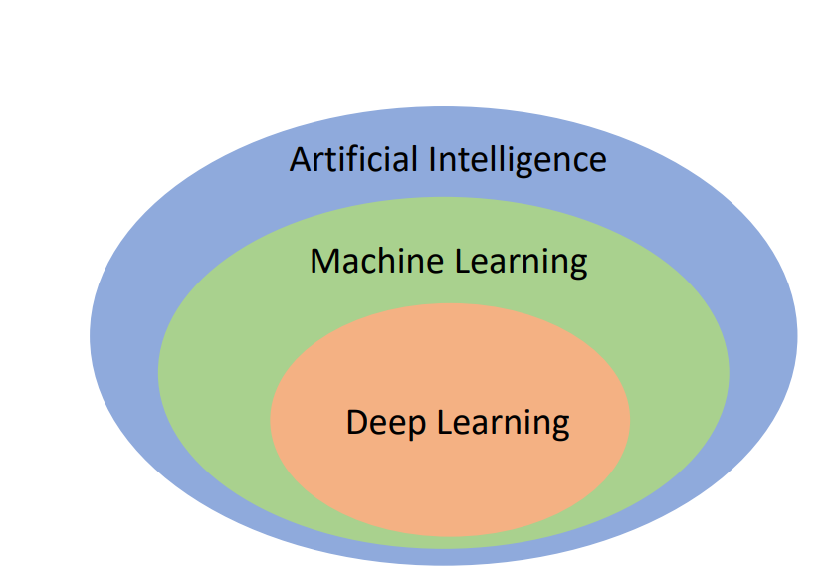
What is Deep Learning (DL) ?
DL is one of ML techniques.
DL refers to training Neural Networks
and very large Neural network

Slide 3
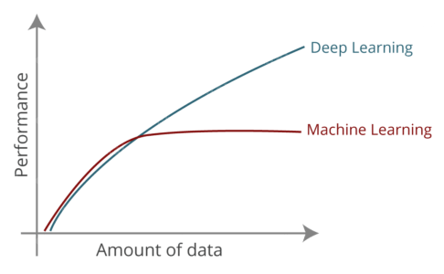
What is Deep Learning (DL) ?
Why we need Deep Learning?
Gives better performance with big data.
Learns features directly from data.
Offers a powerful way to solve complex problems
Usage fields of DL:
Speech recognition, image classification
Nlp, recommendation systems.
Notes:
What is amount of big data? It is hard to answer but 1 million sample is enough to say big amount of data

Slide 4
What is Artificial Neural Network?
NNs are technique that teaches computers to process data in a way that is inspired by the human brain
Notes:
NN looks like black box
Hardware dependence
time

Slide 5
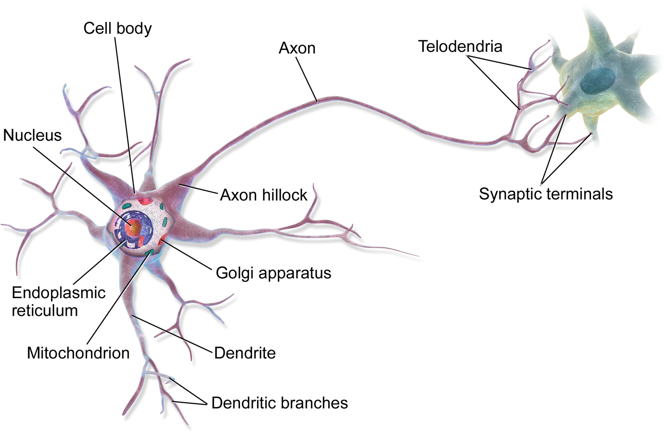
What is Artificial Neural Network?
Notes:
NNs are technique that teaches computers to process data in a way that is inspired by the human brain

Slide 6
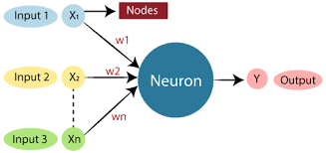
What is Artificial Neural Network?
Notes:
The Perceptron is one of the simplest ANN architectures
ANN VS biology neurons

Slide 7
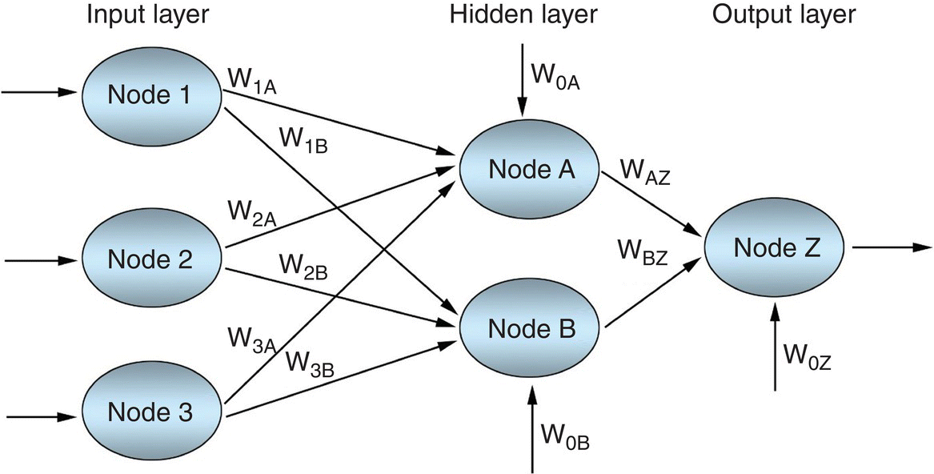
Notes:
An MLP is composed of one (passthrough) input layer, one or more layers of TLUs, called hidden layers, and one final layer of TLUs called the output layer.
The layers close to the input layer are usually called the lower layers, and the ones close to the outputs are usually called the upper layers. Every layer except the output layer includes a bias neuron and is fully connected to the next layer.

Slide 8
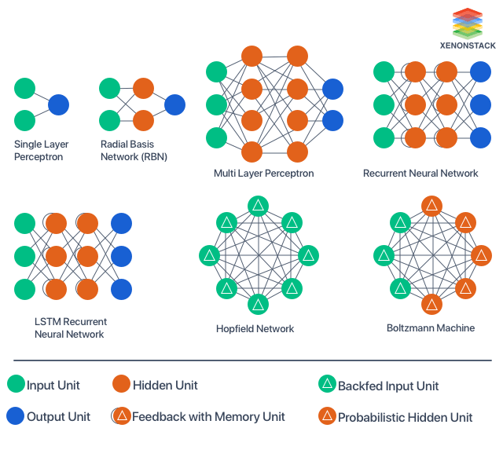
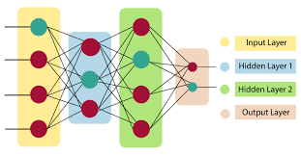

Slide 9

What is hyperparameters?

Slide 10
Key Component and Hyperparameters (1)
Number of layers: input layer, output layer,hidden layer(s)
Number of Neurons: how many neurons in each layers?
Weights : w
Activation function: function used to generate outputs
Forward propagation: where input data is fed through a network, in a forward direction, to generate an output.
Loss (cost) function: to compute error between actual and predict values, some of common cost functions: log-loss, mean square error,cross entropy
Notes:
Number of layers:
Well if the data is linearly separable then you don't need any hidden layers at all.
If data is less complex and is having fewer dimensions or features then neural networks with 1 to 2 hidden layers would work.
If data is having large dimensions or features then to get an optimum solution, 3 to 5 hidden layers can be used.
It should be kept in mind that increasing hidden layers would also increase the complexity of the model and choosing hidden layers such as 8, 9, or in two digits may sometimes lead to overfitting.
The number of hidden neurons should be between the size of the input layer and the output layer.

Slide 11
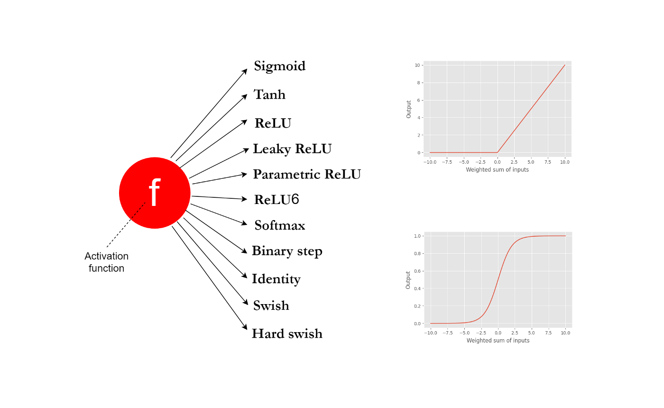
Activation Functions:
transform the summed weighted input from the node into an output value.
add non-linearity to the neural network.
All hidden layers usually use the same activation function.
The output layer will typically use different activation function from the hidden layer
The activation function for the hidden layer will control learning the training data set
The choice of activation function for output layer depends on problem
Notes:
The primary role of the Activation Function is to transform the summed weighted input from the node into an output value to be fed to the next hidden layer or as output.
All hidden layers usually use the same activation function. However, the output layer will typically use a different activation function from the hidden layers. The choice depends on the goal or type of prediction made by the model
the purpose of an activation function is to add non-linearity to the neural network.

Slide 12
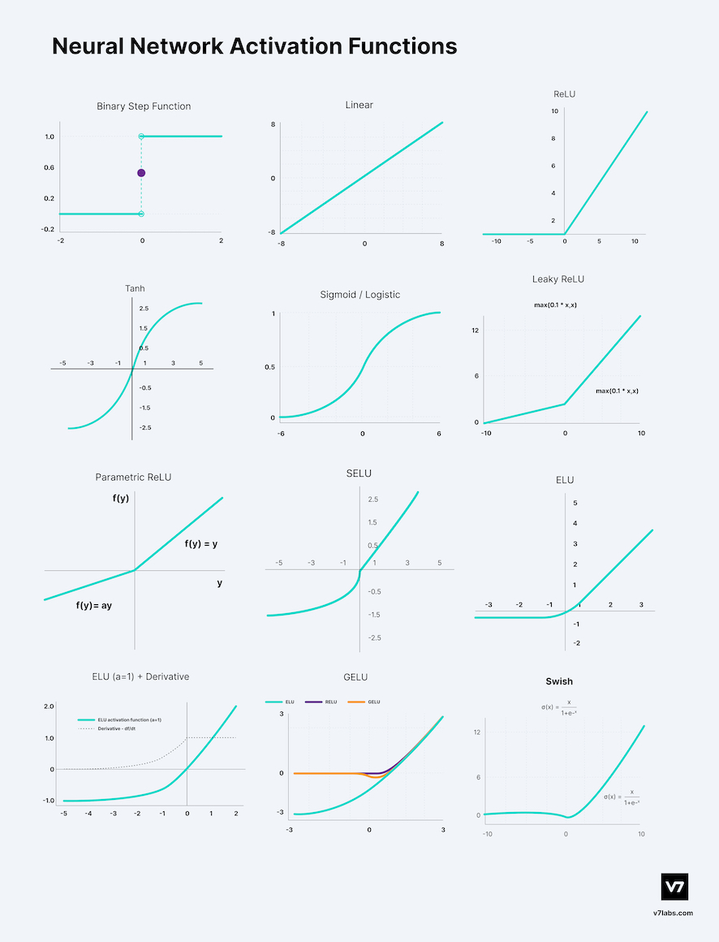
Notes:
popular neural networks activation functions.

Slide 13
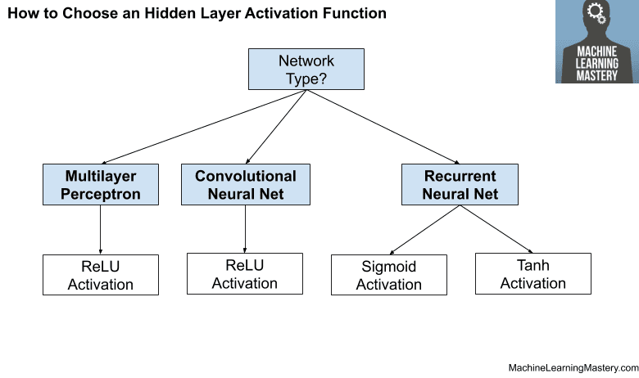
Activation function for Hidden Layers:
Notes:
Depends on type of neural netwok

Slide 14
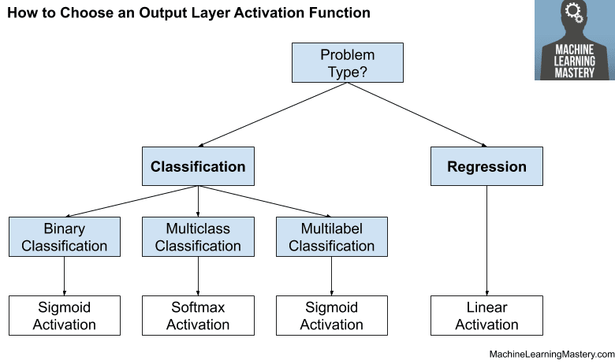
Activation function for output layer:

Slide 15
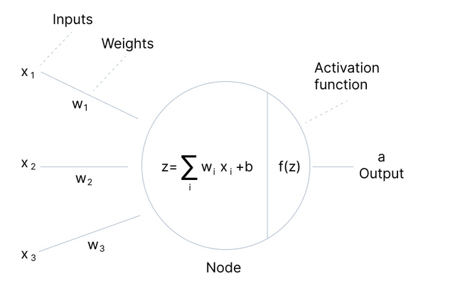
Forward propagation:
z = x1w1+ x2w2+ x3w3+b
a = f(z)

Slide 16
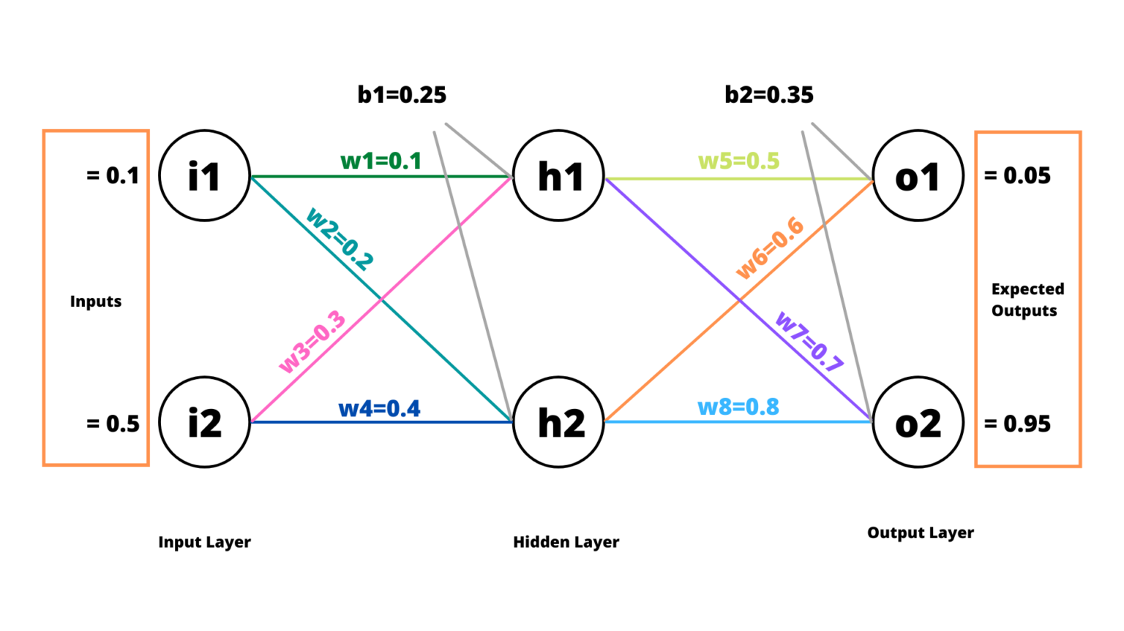
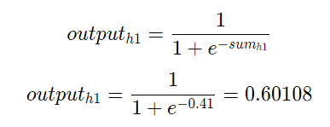

Forward propagation:
sumh1=i1∗w1+i2∗w3+b1
sumh2=i1∗w2+i2∗w4+b1
​

Slide 17
Forward propagation:

Slide 18
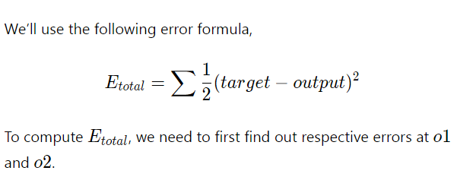
Forward propagation:

Slide 19

If you hope to get more details
here

Slide 20
Key Component and Hyperparameters (2)
Back propagation: back propagate the error, starting from output layer to previous layer and update weights.
Gradient Descent and Optimization Algorithms:used for optimize weights
Epochs: the training of the neural network with all the training data for one cycle.
Batch size: NO. of samples which are processed in one epoch
Notes:
Epochs is one complete set of FP and BP in training
, the batch size is usually between 10 and 1000.

Slide 21
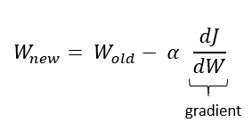
Backpropagation
update the weights in order to minimize the cost function (loss).
using gradient descent and chain rule
Notes:
Back-propagation refers to the method of calculating the gradient of neural network parameters. In
short, the method traverses the network in reverse order, from the output to the input layer,
according to the chain rule from calculus.

Slide 22
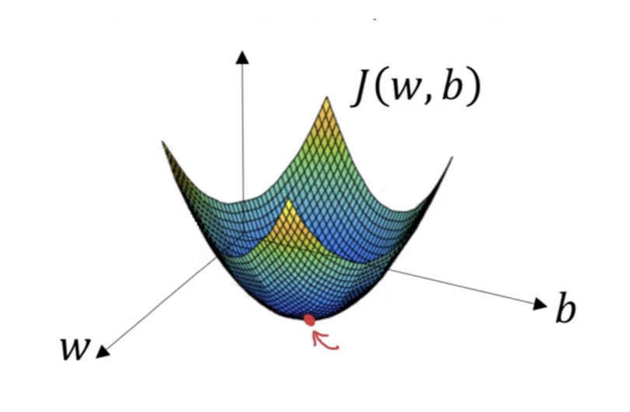
Gradient descent and Learning Rate
Gradient Descent is the most common optimization algorithm*
our model needs to learn the parameters weights and bias that minimize cost function.
Advantages: Easy computation. Easy to implement. Easy to understand.
Disadvantages: if the dataset is too large , this may take long time to converge to the minima. Requires large memory to calculate gradient on the whole dataset
Notes:
الهدف من خوارزمية النزول التدرجي هو الوصول للخط ذو الدقة الآعلى عن طريق البحث عن أفضل معاملات للتعويض في دالة التنبؤ وتوقع القيمة المرادة بأعلى دقة ممكنة. يمكن استخدام النزول التدرجي مع الكثير من خوارزميات تعلم الآلة، ولا تقتصر على الانحدار.
Weights are changed after calculating gradient on the whole dataset.

Slide 23
Gradient descent and Learning Rate
The learning rate determines how big the step would be on each iteration.
If it is too small, the model will converge or descend slowly
if the learning rate is too large, the model may take gigantic descents and miss the global minimum
The most commonly used rates are : 0.001, 0.003, 0.01, 0.03, 0.1, 0.3
Notes:
This is a hyperparameter that specifies how fast a neural network updates its
gradient parameters. If the learning rate is too small, the model will converge or descend slowly
and this can be computationally expensive. However, if the learning rate is too large, the model
may take gigantic descents and miss the global minimum. A good practice is to use a decaying
learning rate – that is one that starts out large and changes to a small value overtime.

Slide 24
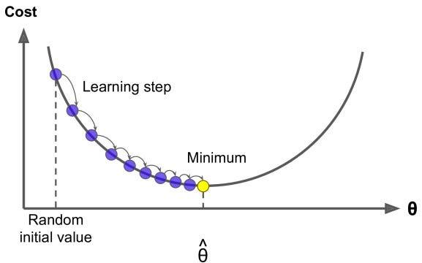
Gradient descent and Learning Rate
Notes:
This is a hyperparameter that specifies how fast a neural network updates its
gradient parameters. If the learning rate is too small, the model will converge or descend slowly
and this can be computationally expensive. However, if the learning rate is too large, the model
may take gigantic descents and miss the global minimum. A good practice is to use a decaying
learning rate – that is one that starts out large and changes to a small value overtime.

Slide 25
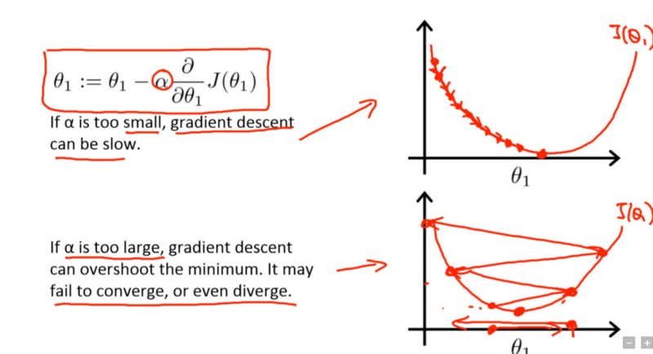
Gradient descent and Learning Rate

Slide 26
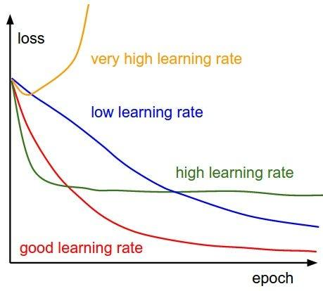
Gradient descent and Learning Rate
Notes:
plot the cost function against different values of α and pick the value of α that is right before the first value that didn’t converge so that we would have a very fast learning algorithm that converges
There are many different strategies to reduce the learning rate during training. It can also be beneficial to start with a low learning rate, increase it, then drop it again. These strategies are called learning schedules.

Slide 27
The Vanishing/Exploding Gradients Problems
Notes:
As we discussed, the backpropagation algorithm works by going from the output layer to the input layer, propagating the error gradient along the way. Once the algorithm has computed the gradient of the cost function with regard to each parameter in the network, it uses these gradients to update each parameter with a Gradient Descent step.
Unfortunately, gradients often get smaller and smaller as the algorithm progresses down to the lower layers. As a result, the Gradient Descent update leaves the lower layers’ connection weights virtually unchanged, and training never converges to a good solution. We call this the vanishing gradients problem.
In some cases, the opposite can happen: the gradients can grow bigger and bigger until layers get insanely large weight updates and the algorithm diverges. This is the exploding gradients problem. More generally, deep neural networks suffer from unstable gradients; different layers may learn at widely different speeds.

Slide 28
How to solve the problem of Vanishing/Exploding gradients
Using less number of layers
Careful weight initialization
Using the correct activation functions
Using batch normalization
Gradient clipping

